Slide 1
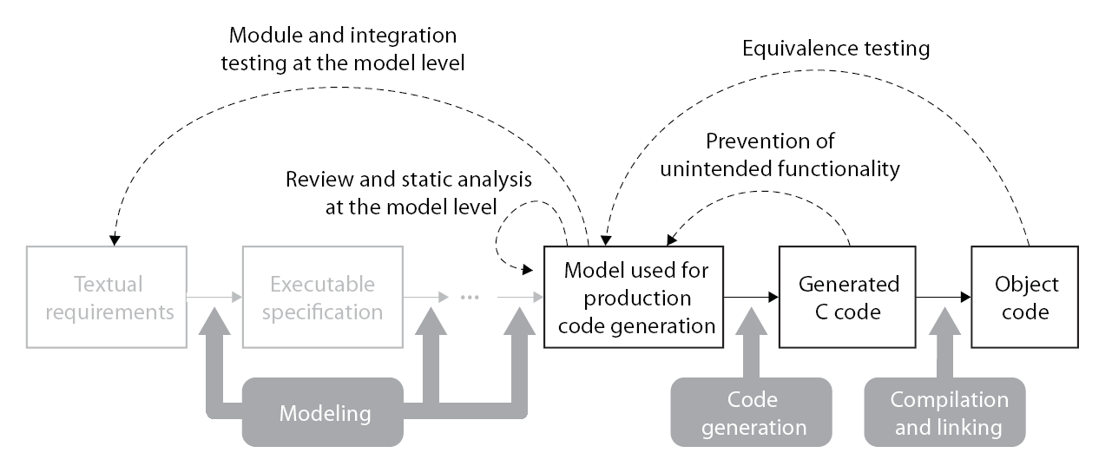
MathWorks IEC 62304 Workshop
MathWorks Reference Workflow with TÜV SÜD Qualification
Upper Process Lower Process
Relationship between IEC62304 and IEC 61508
IEC 61508 is referred to as good practice for implementing the requirements of IEC 62304
 | IEC 61508 | IEC 62304
Safety Integrity Levels | SIL 1 – 4; 1 being lowest Considering probability and severity | Class A – C; A being lowest Considering only severity
Independence of verification | Strong emphasis for higher SIL | Not emphasised
IEC Certification Kit Templates for IEC 61508 Certification
Conformance Demonstration Template (IEC Certification Kit)
Paste the MATLAB/Simulink Deliverables to the Templates
Documentations for IEC61508 Certification

Slide 2
Using Simulink for Software Design
MathWorks Reference Workflow with TÜV SÜD Qualification
Upper Process Lower Process
Correspondence between IEC61508Tables and MathWorks Reference Workflow
Table A. 1 Software Safety Requirements Specification
Table A. 2 Software Design and Development – Software Architecture Design
Table A. 3 Software Design and Implementation – Support Tools and Programming Language
Table A. 4 Software Design and Development – Detailed Design
Table A. 10 Functional Safety Assessment
Table B. 5 Modeling
Table B. 7 Semi-formal Methods
Table B. 9 Modular Approach
Table A. 5 Software Design and Development – Software Module Testing and Integration
Table A. 7 Software Aspects of System Safety Validation
Table A. 8 Modification
Table A. 9 Software Verification
Table B. 1 Design and Coding Standards
Table B. 2 Dynamic Analysis and Testing
Table B. 3 Functional and Black-Box Testing
Table B. 8 Static Analysis
Table B. 9 Modular Approach
Table A. 6 Programmable Electronics Integration (Hardware and Software)
Table B. 1 Design and Coding Standards
Table B. 2 Dynamic Analysis and Testing
Table B. 6 Performance Testing
Table B. 8 Static Analysis
Table B. 9 Modular Approach
IEC 61508 Deliverables Generated from MATLAB/Simulink Productions
Simulink | Stateflow
Simulink Verification and Validation | Simulink Report Generator
Simulink | Stateflow
Simulink Fixed-Point | Simulink Design Verifier
Simulink Verification and Validation | Simulink Report Generator
Simulink | Stateflow
Simulink Fixed-Point | Simulink Design Verifier
Simulink Verification and Validation | Simulink Report Generator
Embedded Coder | Polyspace
- Simulink models with Hierarchical Structure
- Stateflow Charts
- Model Dependency Viewer Reports
- Model Advisor Reports
- The text specification inside Doc Block or Model Info Block
- Reports Generated from Simulink Report Generator
…
- Simulink models with Hierarchical Structure
- Stateflow Charts
- SVG Format Files for showing Simulink Model Information inside Web Brower
- Model Advisor Reports
- Reports Generated from Simulink Report Generator
- System Design Description Report
- Traceability Reports for Requirements
- Test Cases Generated from SLDV
- Harness Model for Test and Verification
- Model Coverage Reports
…
- Test Cases Generated from SLDV
- Harness Model for Test and Verification
- Model Coverage Reports
- Code Coverage Reports
- SIL Model for Back2Back Test
- PIL Model for Back2Back Test
…

Slide 3
Design Verification
MathWorks Reference Workflow with TÜV SÜD Qualification
Upper Process Lower Process
Correspondence between IEC61508Tables and MathWorks Reference Workflow
Table A. 1 Software Safety Requirements Specification
Table A. 2 Software Design and Development – Software Architecture Design
Table A. 3 Software Design and Implementation – Support Tools and Programming Language
Table A. 4 Software Design and Development – Detailed Design
Table A. 10 Functional Safety Assessment
Table B. 5 Modeling
Table B. 7 Semi-formal Methods
Table B. 9 Modular Approach
Table A. 5 Software Design and Development – Software Module Testing and Integration
Table A. 7 Software Aspects of System Safety Validation
Table A. 8 Modification
Table A. 9 Software Verification
Table B. 1 Design and Coding Standards
Table B. 2 Dynamic Analysis and Testing
Table B. 3 Functional and Black-Box Testing
Table B. 8 Static Analysis
Table B. 9 Modular Approach
Table A. 6 Programmable Electronics Integration (Hardware and Software)
Table B. 1 Design and Coding Standards
Table B. 2 Dynamic Analysis and Testing
Table B. 6 Performance Testing
Table B. 8 Static Analysis
Table B. 9 Modular Approach
IEC 61508 Deliverables Generated from MATLAB/Simulink Productions
Simulink | Stateflow
Simulink Verification and Validation | Simulink Report Generator
Simulink | Stateflow
Simulink Fixed-Point | Simulink Design Verifier
Simulink Verification and Validation | Simulink Report Generator
Simulink | Stateflow
Simulink Fixed-Point | Simulink Design Verifier
Simulink Verification and Validation | Simulink Report Generator
Embedded Coder | Polyspace
- Simulink models with Hierarchical Structure
- Stateflow Charts
- Model Dependency Viewer Reports
- Model Advisor Reports
- The text specification inside Doc Block or Model Info Block
- Reports Generated from Simulink Report Generator
…
- Simulink models with Hierarchical Structure
- Stateflow Charts
- SVG Format Files for showing Simulink Model Information inside Web Brower
- Model Advisor Reports
- Reports Generated from Simulink Report Generator
- System Design Description Report
- Traceability Reports for Requirements
- Test Cases Generated from SLDV
- Harness Model for Test and Verification
- Model Coverage Reports
…
- Test Cases Generated from SLDV
- Harness Model for Test and Verification
- Model Coverage Reports
- Code Coverage Reports
- SIL Model for Back2Back Test
- PIL Model for Back2Back Test
…

Slide 4
Code Verification
MathWorks Reference Workflow with TÜV SÜD Qualification
Upper Process Lower Process
Correspondence between IEC61508Tables and MathWorks Reference Workflow
Table A. 1 Software Safety Requirements Specification
Table A. 2 Software Design and Development – Software Architecture Design
Table A. 3 Software Design and Implementation – Support Tools and Programming Language
Table A. 4 Software Design and Development – Detailed Design
Table A. 10 Functional Safety Assessment
Table B. 5 Modeling
Table B. 7 Semi-formal Methods
Table B. 9 Modular Approach
Table A. 5 Software Design and Development – Software Module Testing and Integration
Table A. 7 Software Aspects of System Safety Validation
Table A. 8 Modification
Table A. 9 Software Verification
Table B. 1 Design and Coding Standards
Table B. 2 Dynamic Analysis and Testing
Table B. 3 Functional and Black-Box Testing
Table B. 8 Static Analysis
Table B. 9 Modular Approach
Table A. 6 Programmable Electronics Integration (Hardware and Software)
Table B. 1 Design and Coding Standards
Table B. 2 Dynamic Analysis and Testing
Table B. 6 Performance Testing
Table B. 8 Static Analysis
Table B. 9 Modular Approach
IEC 61508 Deliverables Generated from MATLAB/Simulink Productions
Simulink | Stateflow
Simulink Verification and Validation | Simulink Report Generator
Simulink | Stateflow
Simulink Fixed-Point | Simulink Design Verifier
Simulink Verification and Validation | Simulink Report Generator
Simulink | Stateflow
Simulink Fixed-Point | Simulink Design Verifier
Simulink Verification and Validation | Simulink Report Generator
Embedded Coder | Polyspace
- Simulink models with Hierarchical Structure
- Stateflow Charts
- Model Dependency Viewer Reports
- Model Advisor Reports
- The text specification inside Doc Block or Model Info Block
- Reports Generated from Simulink Report Generator
…
- Simulink models with Hierarchical Structure
- Stateflow Charts
- SVG Format Files for showing Simulink Model Information inside Web Brower
- Model Advisor Reports
- Reports Generated from Simulink Report Generator
- System Design Description Report
- Traceability Reports for Requirements
- Test Cases Generated from SLDV
- Harness Model for Test and Verification
- Model Coverage Reports
…
- Test Cases Generated from SLDV
- Harness Model for Test and Verification
- Model Coverage Reports
- Code Coverage Reports
- SIL Model for Back2Back Test
- PIL Model for Back2Back Test
…

